Slide 1
DATA 230 Mathematical Methods for Data Analysis Week 2
Department of Applied Data Science San Jose State University Instructor: Robert Nicholson
sjsu.edu/people/robert.nicholson

Slide 2
Reporting Problems
Not Good: “I’m trying to run the demo and it doesn’t work.”
The right way to report a problem

Slide 3
Reporting Problems
Give a top level (but specific) description of the problem: “I’m in your CMPE 199 class. I’m trying to run the demo from class yesterday, and I’m getting an error message”

Slide 4
Reporting Problems
List, step by step, what you did:
I downloaded the example from canvas
I ran it from the command line using the following command:
•
•
•

Slide 5
Reporting Problems
Describe exactly what happened, including the text of any messages. Incluse a screen shot of necessary:
“At that point, I got the following error message:”
‘Unknown symbol XYZZY in line 276’

Slide 6
Reporting Problems
Give additional information on the environment:
“I’m running Python 3.9 on MacOS Version 12.1”

Slide 7
Data Collection, Transformation, and Aggregation for Visualization
(And for Analysis)

Slide 8
An Effective Presentation Requires
A clear goal (a story to tell)
Good data
The right chart type
Good design and layout decisions

Slide 9
Where Does Data Come From?
Data collection is the process of gathering, measuring, and analyzing data from a variety of relevant sources to find answers to research problems, answer questions, evaluate outcomes, and forecast trends and probabilities

Slide 10
Data Sources
Transactional Data (sales)
Monitoring & Tracking (instrumentation)
Observation & Measurements (counting things)
Data Mining (information repositories)
Paper documents
Data Scraping (social media, web directories, etc)
Surveys & Polls
In person, telephone, online, interviews
Acquiring / Purchasing

Slide 11
Data Transformation
The process of converting data from the format of a source - whatever it might be - into the format required for the intended purpose (in our case, visualization).

Slide 12
A Data Scientist Spends 80% of Their Time?
Finding ways to spend all the money they are paid
– OR –
Data Wrangling
cleaning, preparing, and transforming their data

Slide 13
Data Wrangling
Cleaning the data
Eliminating “bad” data points (errors in data)
Eliminating outliers
Transforming the data
Format changes required by APIs and tools
Changing scale or units
Manipulating, aggregating and analyzing the data

Slide 14
Reformatting
CSV file to a Python array
Database to a text file
Paper forms to a database

Slide 15
Data Filtering
Data filtering can refer to a wide range of strategies or solutions for refining data sets. This means the data sets are refined into simply what a user (or set of users) needs, without including other data that can be repetitive, irrelevant or even sensitive.
Technopedia

Slide 16
Data Anonymizing / Masking
Removing identifying information, usually for privacy reasons
Risk factor: remaining information may still allow unique identification
Example:
In 2006, Netflix published 10 million movie rankings by 500,000 customers without names
researchers at the University of Texas at Austin “de-anonymized” some of the Netflix data by comparing rankings and timestamps with public information in the Internet Movie Database, or IMDb

Slide 17
Data Anonymizing / Masking
Another (bad) Example:
Data Field | Value
Name | Juan Garcia
Address | 1234 Main Street, Anywhere, CA
Age | 44
Relationship Status | Married
Children | 3
Race | White / Hispanic
Car | 2018 Ford Explorer, Black
Employer | Apple Computer
Previous Employer | Hewlett-Packard
Highest Degree | MS, Computer Science, Stanford University, 2001

Slide 18
Aggregating Data from Multiple Sources
Homogeneous Data Sources
Represent the same information, but in different ways
Different timescales: daily, weekly, monthly
Different units of measure
Example: crop yields from different counties in the United States in the 1800s

Slide 19
Aggregating Data from Multiple Sources
Heterogeneous Data Sources
Represent different information
Combine using a common field
Example: compute profit per store location
Sales reports per location
Labor expenses per location
Purchase and inventory costs per location
Overhead per location
More complex combinations are possible using multiple fields

Slide 20
Combining Heterogeneous Data
In a relational database, this is often accomplished with a join operation
A join is an SQL operation performed to establish a connection between two or more database tables based on matching columns, thereby creating a relationship between the tables.

Slide 21
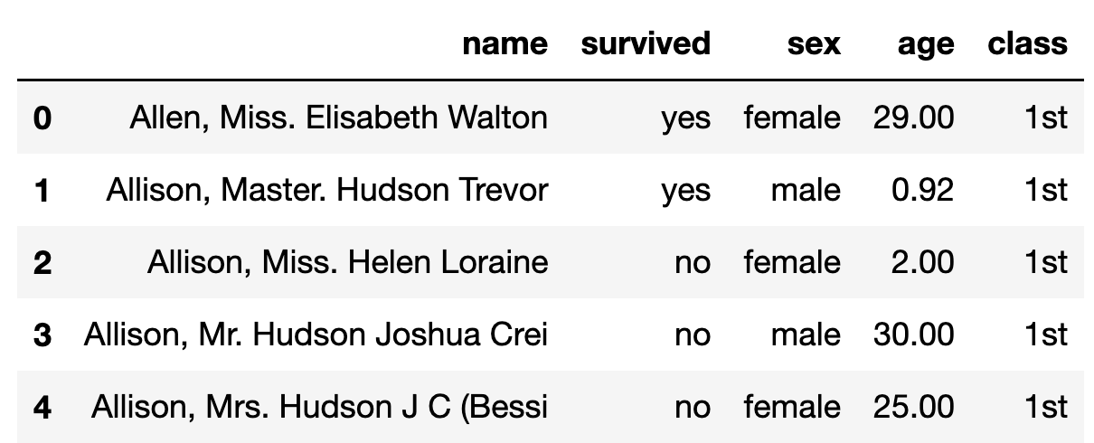
Data Cleaning
The Titanic Data Set
1,046 passenger records
Some records are incomplete (requires cleaning)

Slide 22
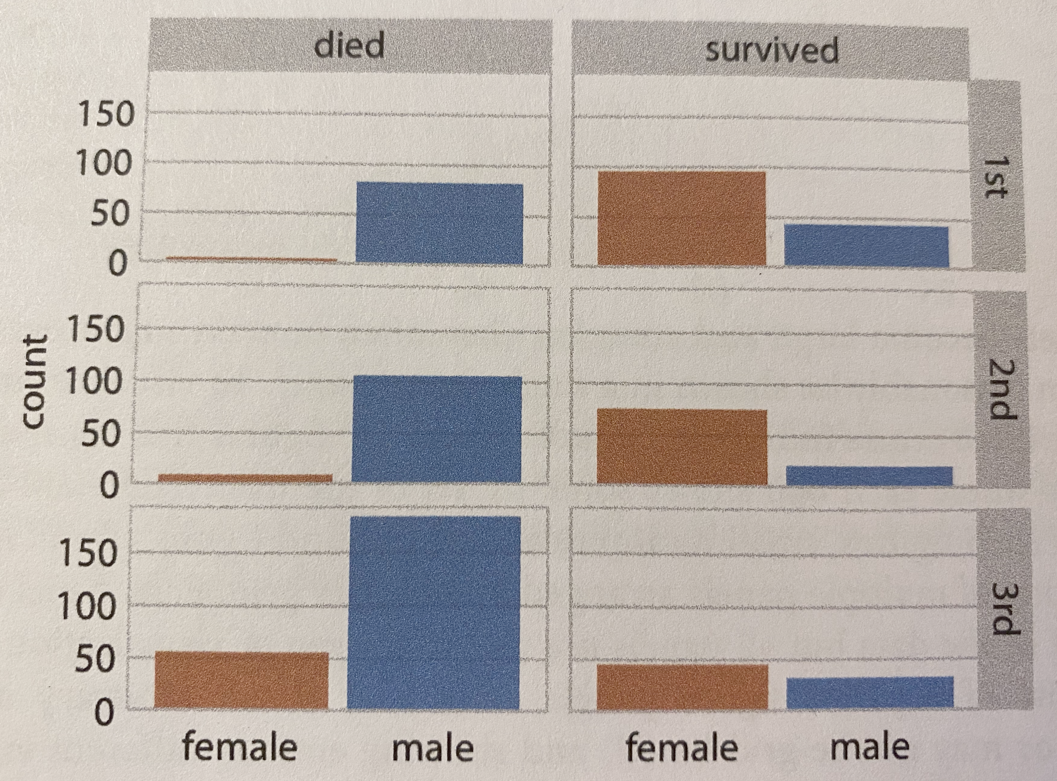
Computing Statistics
How was the data transformed?
Counting!

Slide 23
Data Item Transformation
Scaling
Unit conversions
“Discretizing” continuous variables
Examples: temperatures, stock prices
Converting categorical (label) data to numeric
Most tools require numeric data

Slide 24
Converting categorical data to numeric
Ordered Mapping
Small = 1, Medium = 2, Large = 3
Arbitrary Mapping
LAX = 1, SFO = 2, HOU = 3
Try to find a better relationship
Convert Labels to columns
SFO | LAX | HOU | • • •
0 | 1 | 0 | 0

Slide 25
Generalization
Low-level data attributes are transformed into high-level data attributes using concept hierarchies
Original Data:
Ages: 26, 28, 31, 33, 37, 42, 42, 46, 48, 49, 54, 57, 57, 58, 59
Generalized Data:
Ages:
20-29 (2)
30-39 (3)
40-49 (5)
50-59 (5)

Slide 26
Eliminating Outliers
Example: Houses in a neighborhood sell for $2.5 million to $3.5 million
The Median is $3 million
One house formerly belonged to a celebrity, and sells for $5.5 million
The Median is $4 million
Outliers may be eliminated by hand, or mathematically (e.g. values outside 2 standard deviations from the mean)

Slide 27
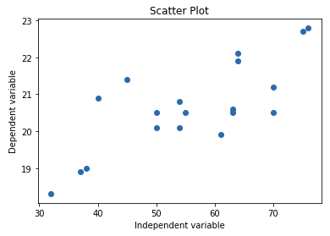
Showing Trends: Individual Data Points

Slide 28
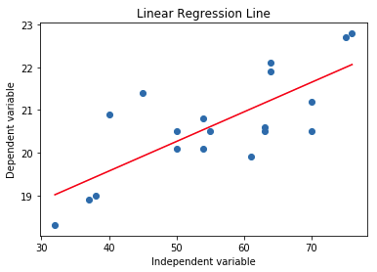
Trend Line
A “best fit” line, computed using linear regression

Slide 29
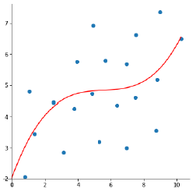
Trend Line
A “best fit” line, computed using polynomial regression

Slide 30
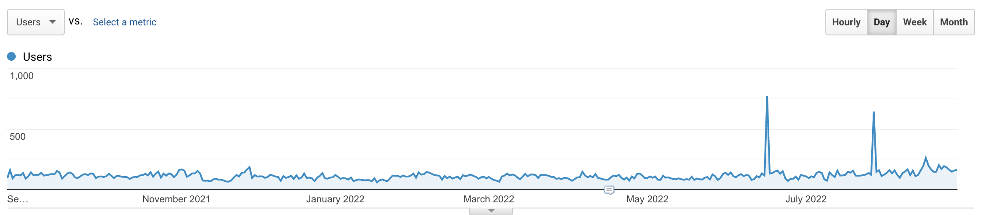
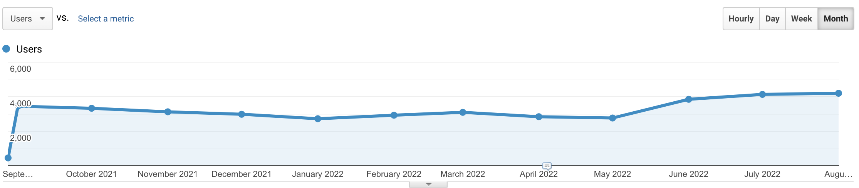
Data Smoothing

Slide 31
Smoothing: Combining Subsets
In the previous example, we used the sum all the daily data points to form monthly totals
We could also use an average, or some other statistic, depending on the point we are trying to make.

Slide 32
Smoothing: Moving Averages
The moving average of y data values over the x values that represent the time intervals:
Each y_{ma} value of the moving average corresponding to the current x time value is the average of the current y value and the previous n-1 of the y values.
Keep a buffer of the last n of the y values. Throw out the oldest y value when you append the newest value.
There can be no y_{ma} moving average values corresponding to the first n-1 of the x values.
Higher values of n generate moving average plots that “smooth out” the data more.
We often see
this for stock prices

Slide 33
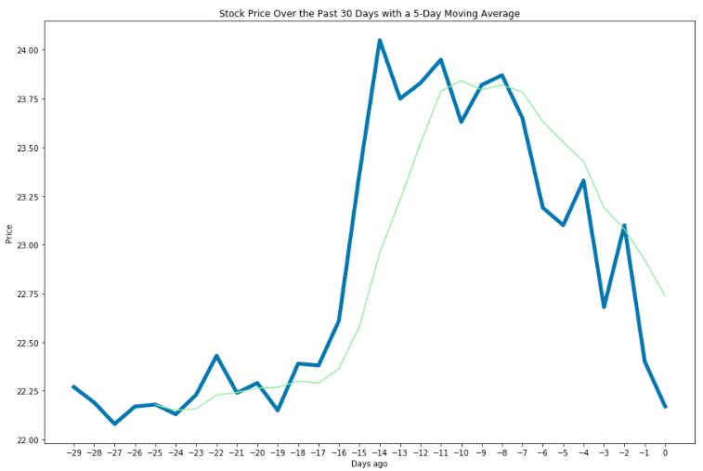
Moving Averages, cont’d
n = 5

Slide 34
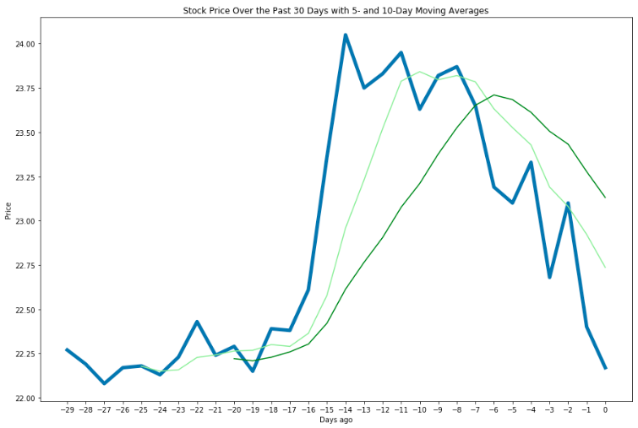
Moving Averages, cont’d
n = 10
n = 5
Larger n smooths the data,
but also lags further

Slide 35
Reducing Dimensions
We are not good at visualizing data beyond three dimensions
Separate data into pairs for graphing
Dimensionality Reduction
TSNE estimator
Principal Component Analysis (PCA) estimator

Slide 36
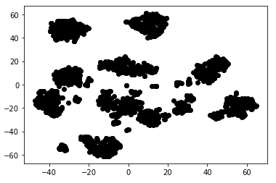
Visualize Dimensionality Reduction
%matplotlib inline
import matplotlib.pyplot as plt
dots = plt.scatter(reduced_digits[:, 0], reduced_digits[:, 1], c='black')
column 0
column 1
The clustering suggests that k-nearest neighbors would be a good supervised machine learning algorithm to apply on the original data.

Slide 37
Automating Data Transformation
Data Visualization may be a continuous process
Company performance on a daily basis
Stock performance minute-by-minute
Data transformation must be automated

Slide 38
Transformation Techniques
Reformatting
Data Filtering
Data Anonymizing (Masking)
Aggregating Homogeneous Data Sources
Aggregating Heterogeneous Data Sources
Data Cleaning: Eliminating Bad Data
Computing Statistics

Slide 39
Transformation Techniques
Data Item Transformation
Eliminating Outliers
Showing Trends
Data Smoothing
Reducing Dimensions
Automating Data Transformation

Slide 40
Assignment 2 – Due Next Week
You’ll submit a document in PDF form for this assignment.
Find three datasets on the Internet
You can use whatever analytical tools or graphic tools you with to familiarize yourself with the data
Describe the dataset, the cleaning and transformation required, and how you would present it.
Submit to Canvas as “Lastname-Assignment-2.pdf”
Also: Read pages 145-160 in the text

Slide 41
Datasets
Many datasets are available on the Internet.
Google “datasets for data analysis”
Kaggle datasets: https://www.kaggle.com/datasets
UCI datasets: https://archive.ics.uci.edu/ml/datasets.php?format=&task=&att=&area=bus&numAtt=10to100&numIns=&type=&sort=dateUp&view=list
Legal datasets: https://lionbridge.ai/datasets/10-best-legal-datasets-for-machine-learning/

